Slide 1
My Projects
Prudhvinath Dittakavi

Slide 2
Contents
End-to-End Data Science Project
Machine Learning from Scratch
Optimal Portfolio

Slide 3
End-to-End Data Science Project

Slide 4
Project1: End-to –End Data Science Project
Problem Statement
Use the provided building energy data to develop a model that can predict a building's Energy Star score, and then interpret the results to find the variables that are most predictive of the score.
Supervised problem: We are given both the features and the target
Regression problem: The target is a continuous variable, in this case ranging from 0-100

Slide 5
Workflow
Data cleaning and formatting
Exploratory data analysis
Feature engineering and selection
Establish a baseline and compare several machine learning models on a performance metric
Perform hyperparameter tuning on the best model to optimize it for the problem
Evaluate the best model on the testing set
Interpret the model results

Slide 6
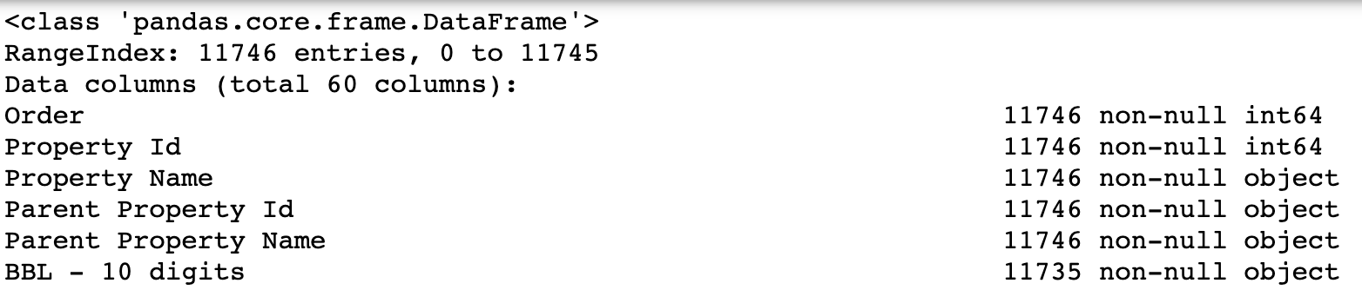
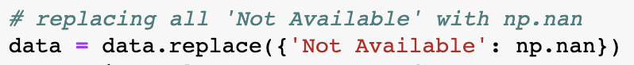
Data Cleaning and Formatting
Understanding the data
Data types and missing values

Slide 7
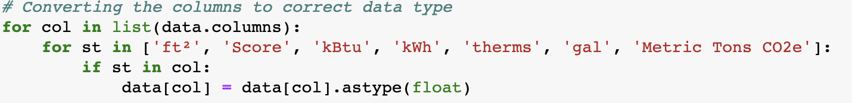
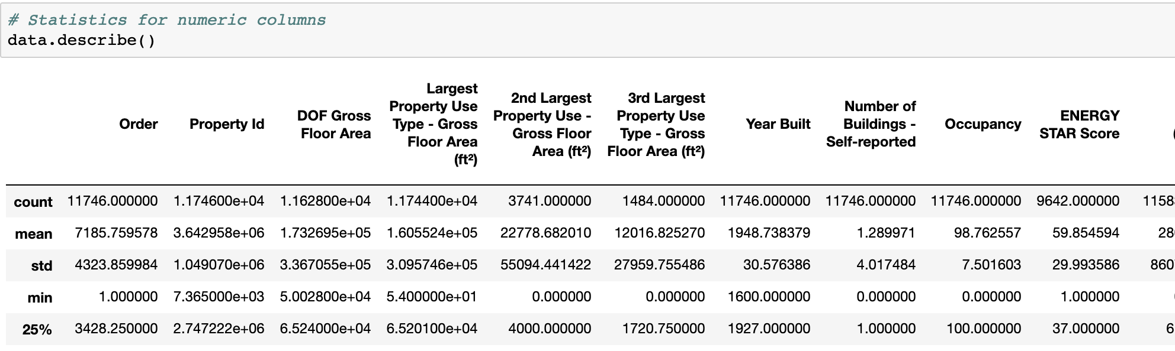
Converting columns to correct data types
Statistics of the numerical columns

Slide 8
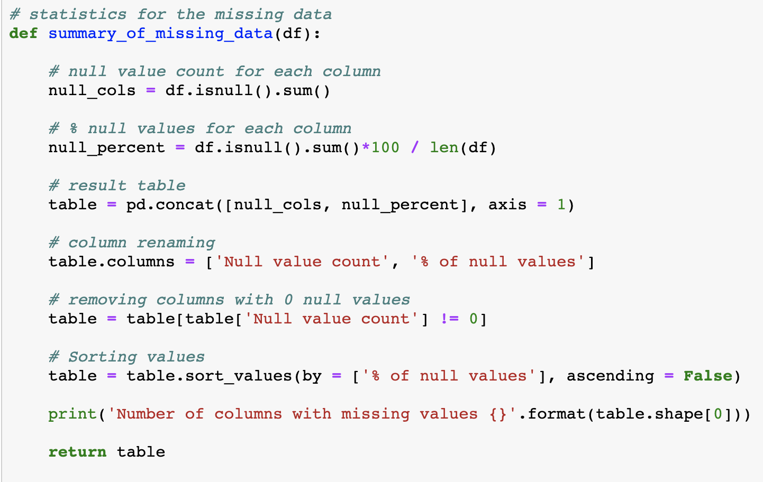
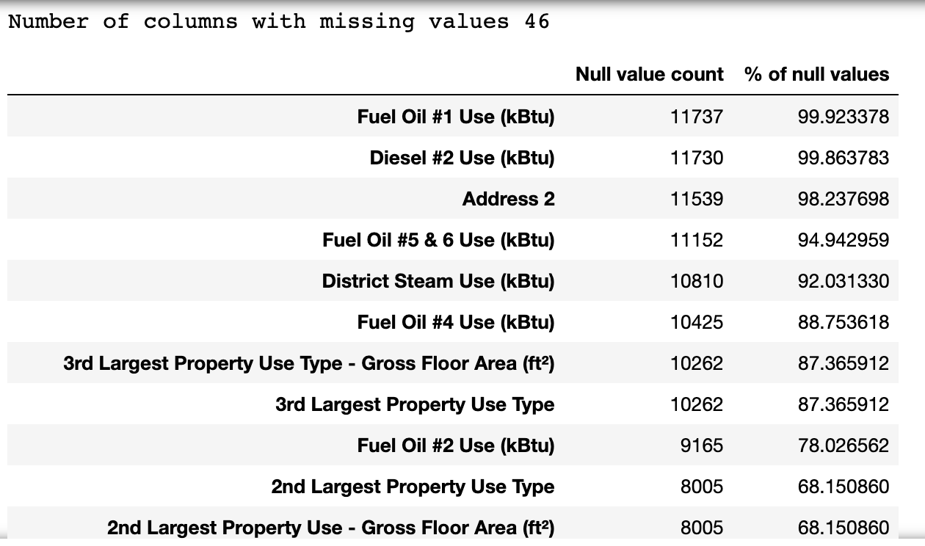
Statistics for missing data

Slide 9
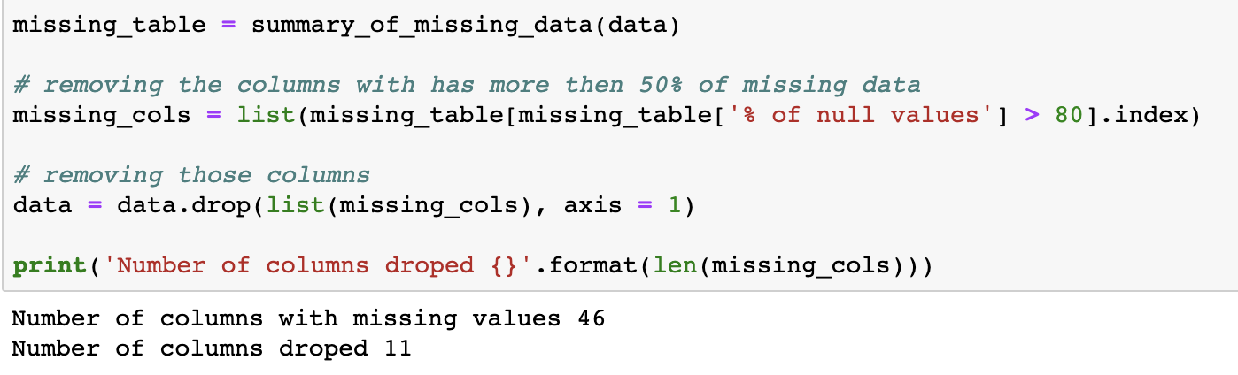
Handling Missing Data

Slide 10
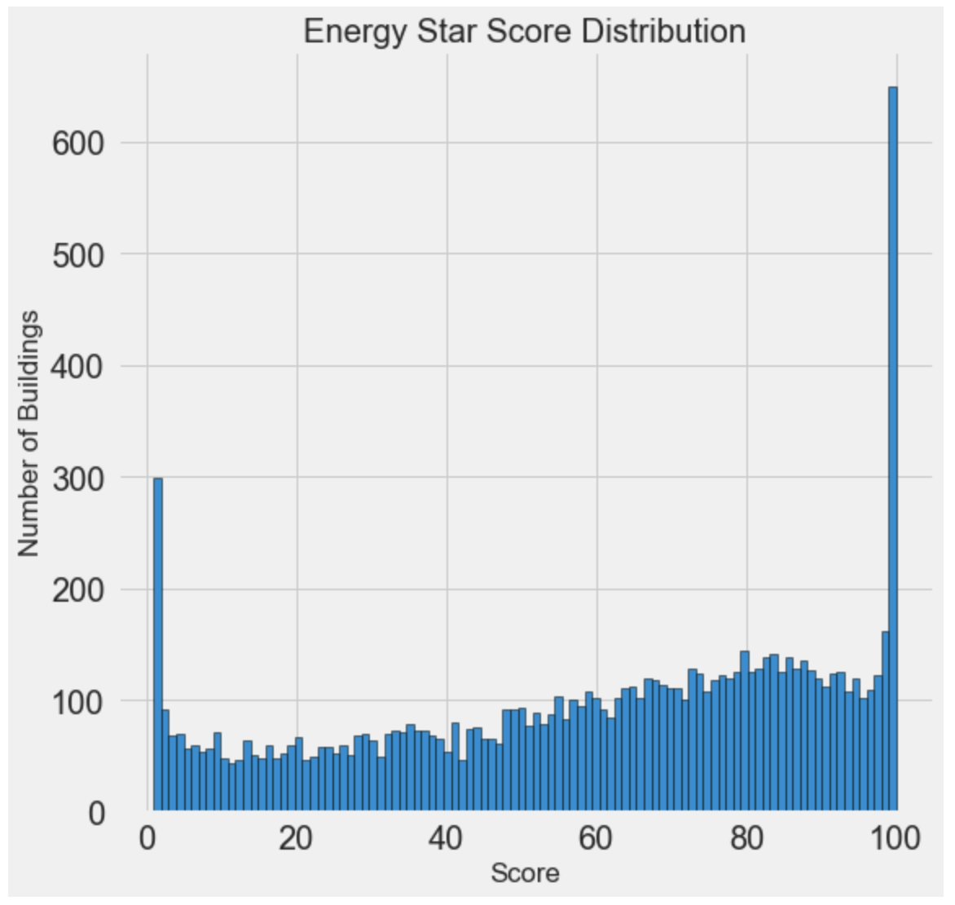
Exploratory Data Analysis – Univariate Analysis

Slide 11
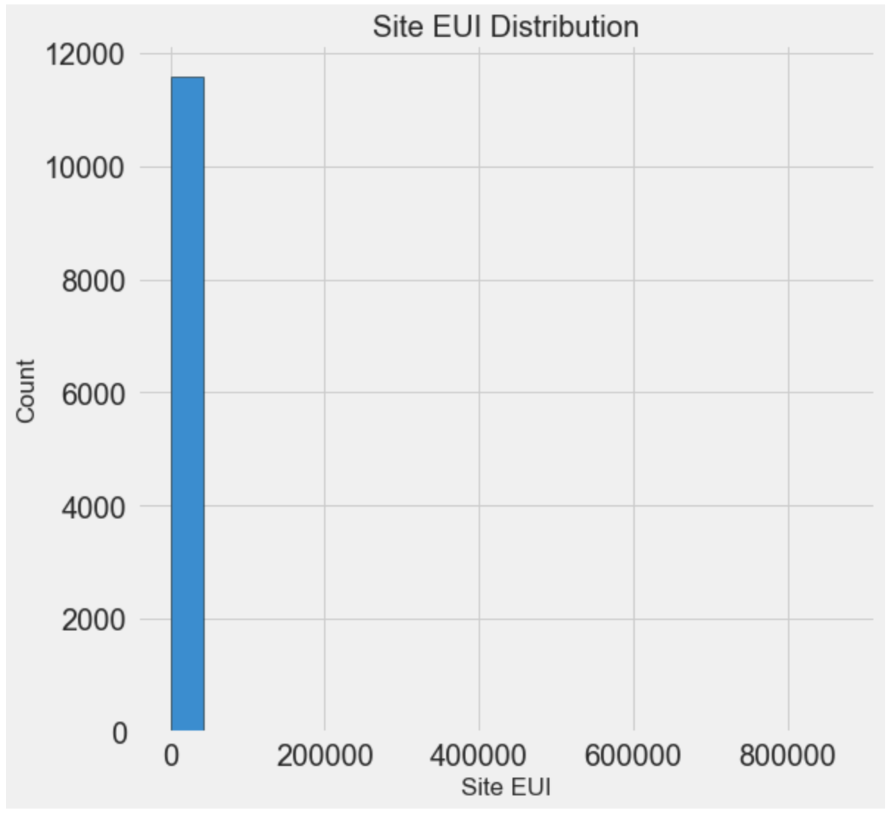
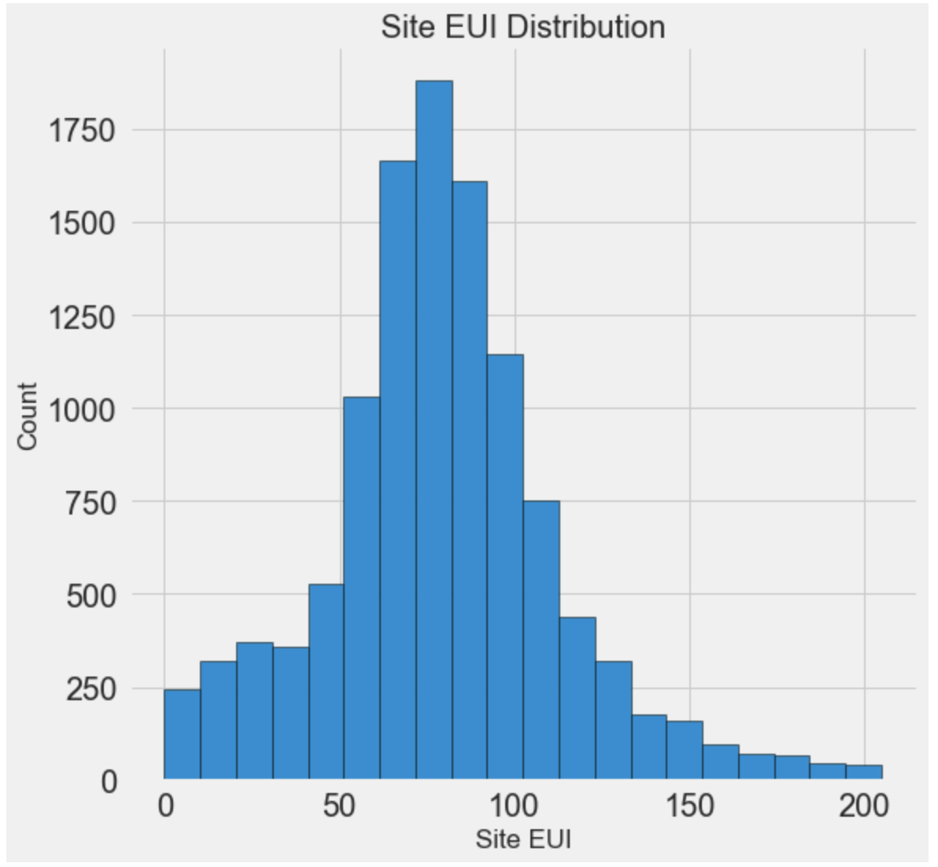
Removing Outliers

Slide 12
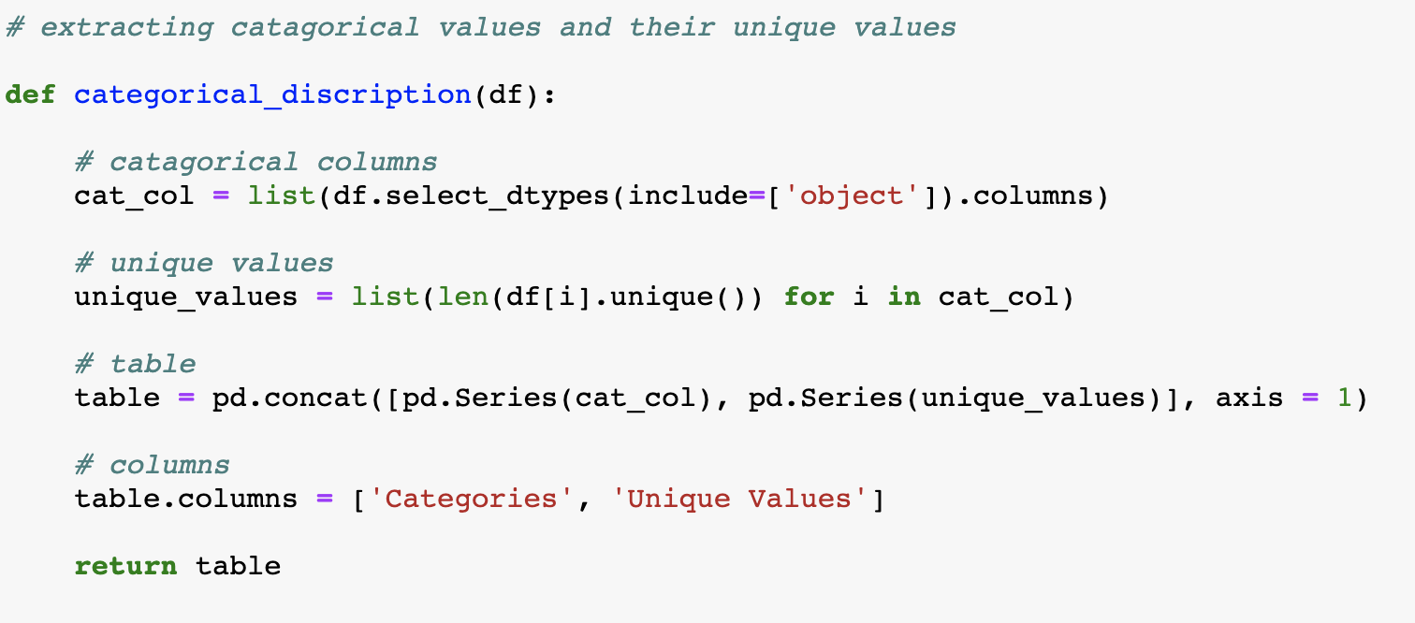
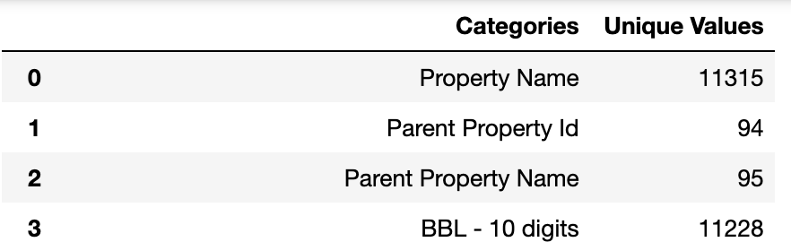
Categorical Variables

Slide 13
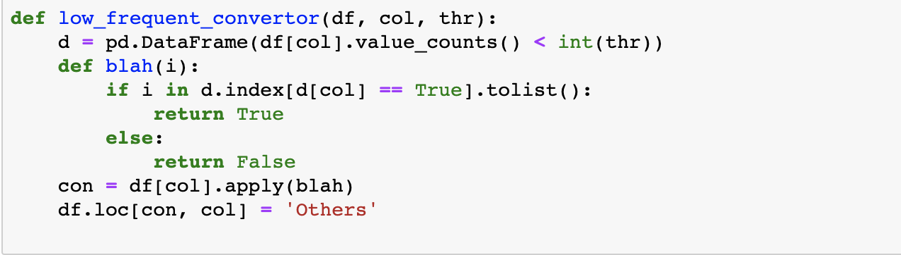
Handling Low Frequency Categorical Columns

Slide 14
Relation between target variable and categorical variable

Slide 15
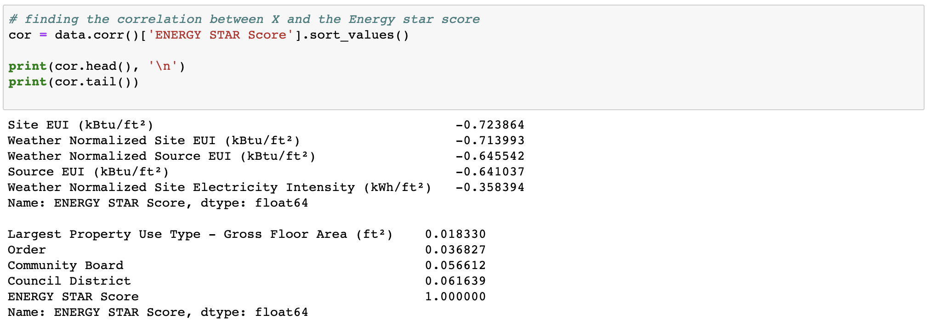
Relation between target variable and continuous variable
Found Correlation between target variable y and the input variable x.

Slide 16
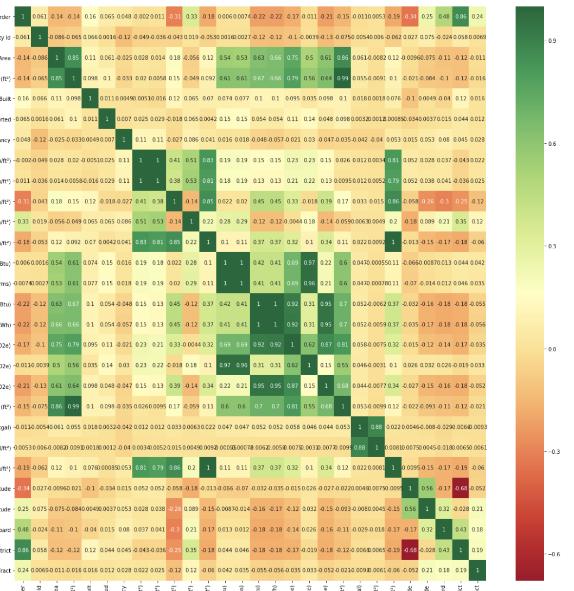
Relation between all continuous variables

Slide 17
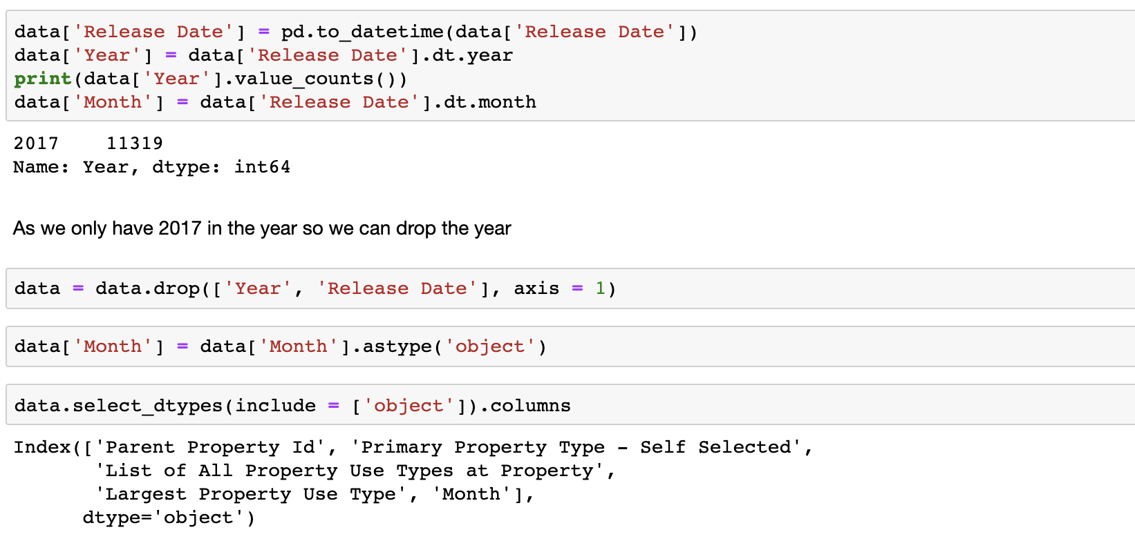
Handling Date Time

Slide 18
Things to be done after train test split
Establish a Baseline
Why Baseline ?
Why Median as Baseline guess ?
Why Mean Absolute Error ?
Our Baseline guess has a mean absolute error of 25.
Imputing Missing Values
Scaling features

Slide 19
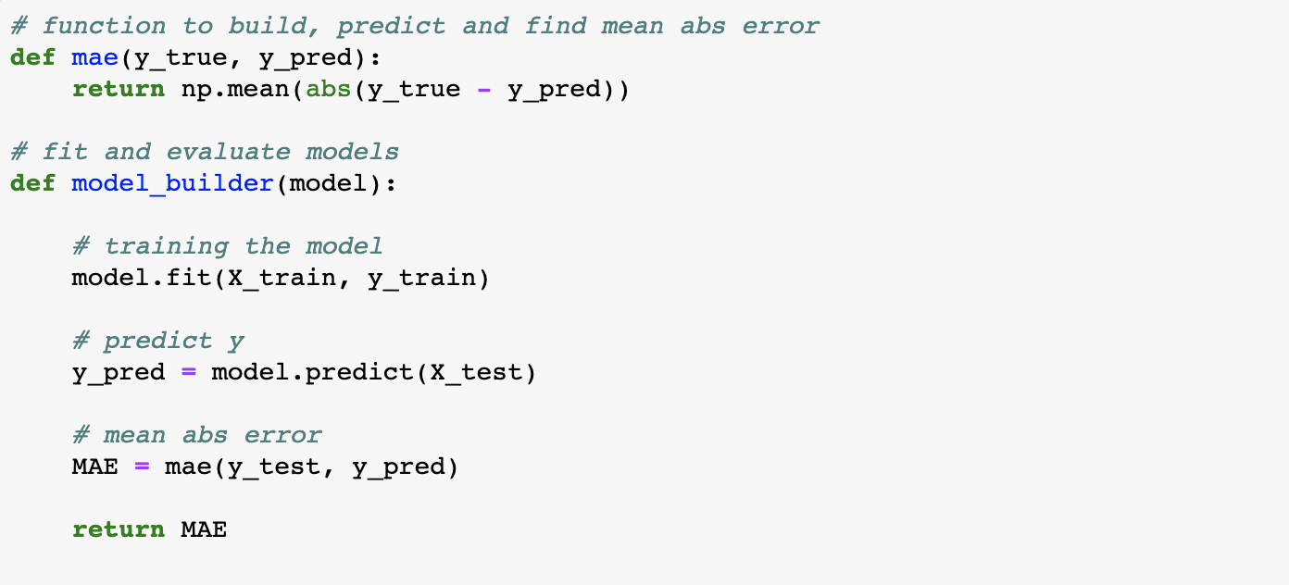
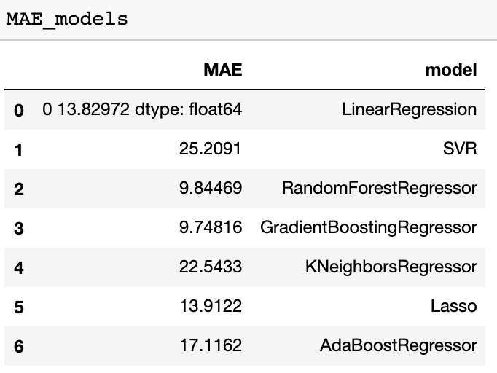
Model Building

Slide 20
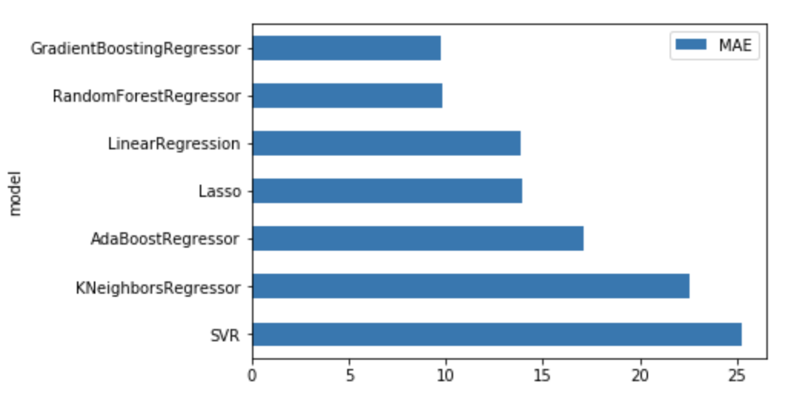
Model Building
As Lasso’s MAE is higher than that of linear regression’s MAE, we can eliminate ridge, elastic net models.
SVM and KNN are doing worse than baseline. So it is best not to choose these models.
By far we can see random forest and gradient boosting are the models with lowest MAE. So we will start tuning these models.

Slide 21
Model Optimization
Gradient Boosting Parameters
The overall parameters can be divided into 3 categories:
Tree-Specific Parameters: These affect each individual tree in the model.
Boosting Parameters: These affect the boosting operation in the model.
Miscellaneous Parameters: Other parameters for overall functioning.

Slide 22
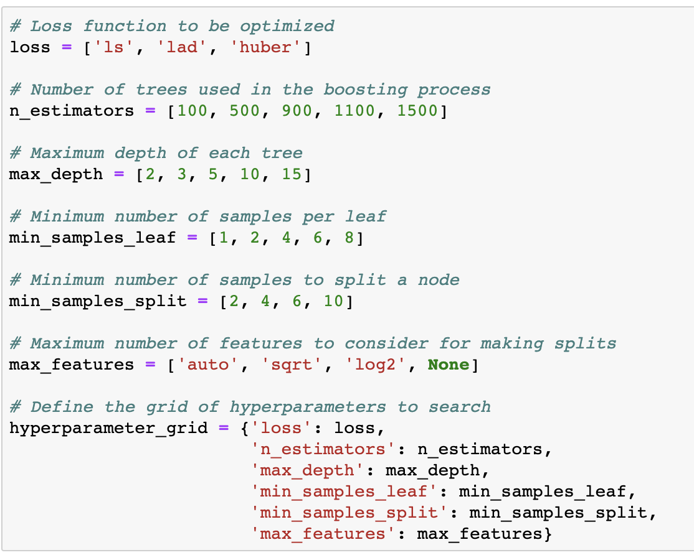
Model Optimization

Slide 23
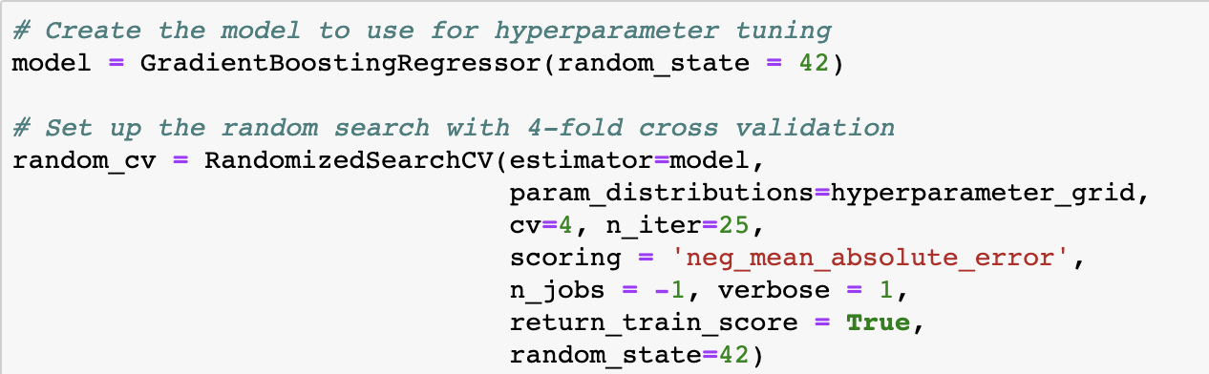
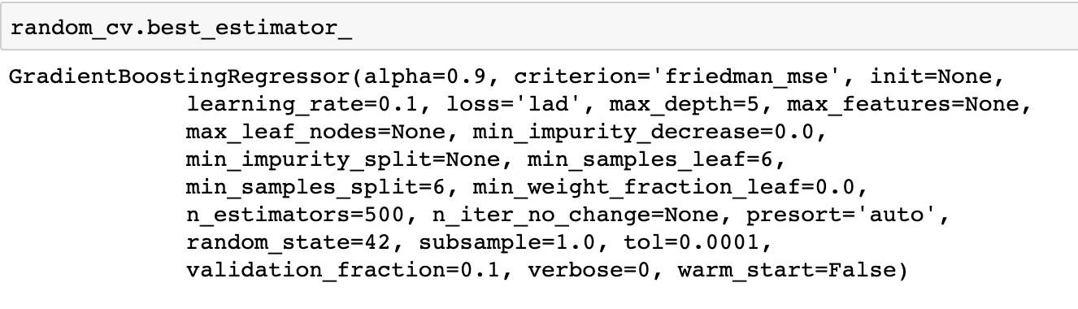
Random Search with Cross Validation

Slide 24
Evaluating if the model is under-fitted or over-fitted
Using the best parameters obtained from random search with cross validation, a model is built.
The training score obtained is: 7.104 Mean Absolute Error
The test score obtained is: 9.024 Mean Absolute Error
The test score(MAE) is almost 27% higher than the train score. This means that the model is over-fitted.
To handle the over-fitting, the model should be made less complex.

Slide 25
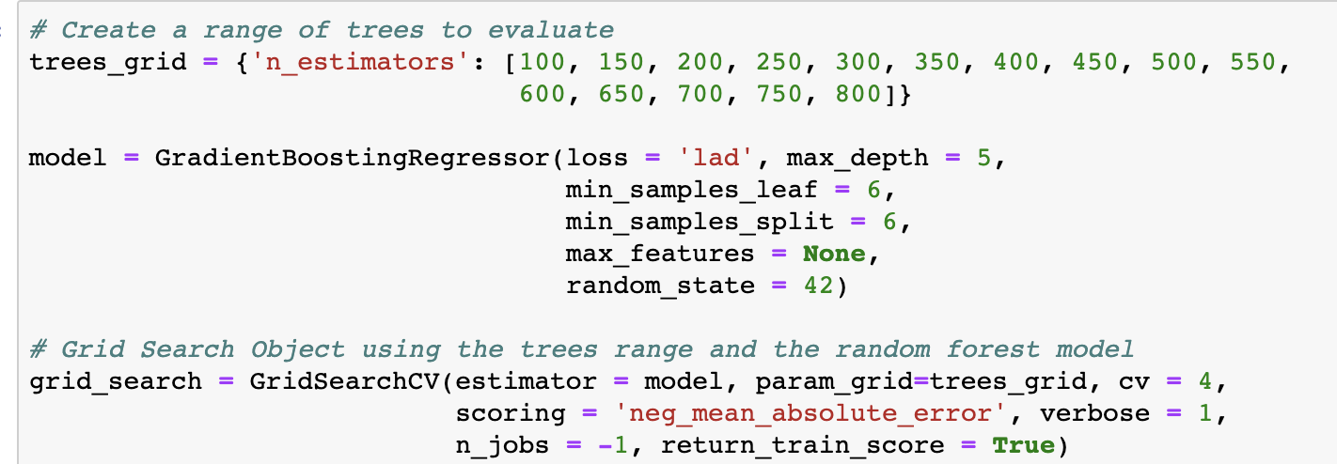
Handling over-fit of the model
Finding the optimal number of tress
The optimal number of trees selected is 300

Slide 26
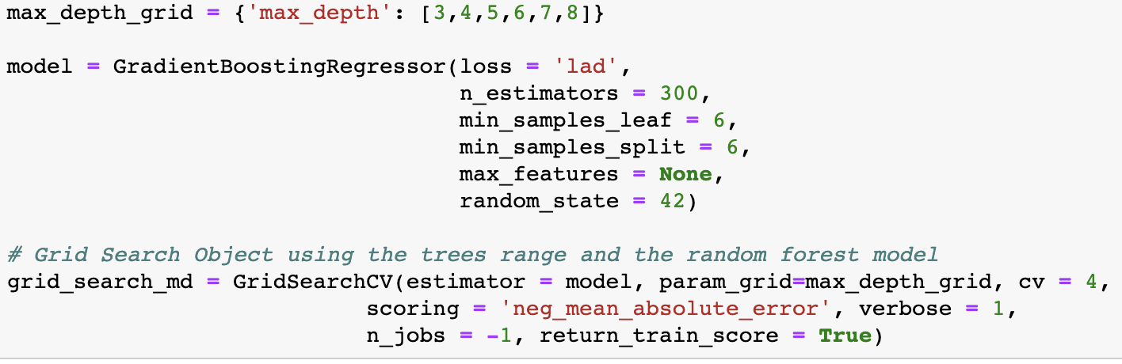
Finding the optimal number of maximum depth
The optimal maximum depth selected is 4

Slide 27
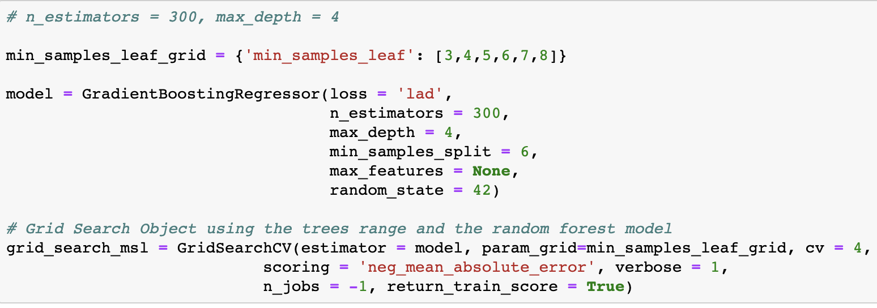
Finding the optimal minimum sample leaf
Performance vs Min Sample Leaf
The optimal minimum sample leaf selected is 7
Minimum Sample Leaf

Slide 28
After fitting the model with new optimal values
The training score increased from 7.104 to 8.02
The test score increased from 9.024 to 9.12
Now, the test score is 13% more than that of training score compared to the previous difference of 27%.

Slide 29
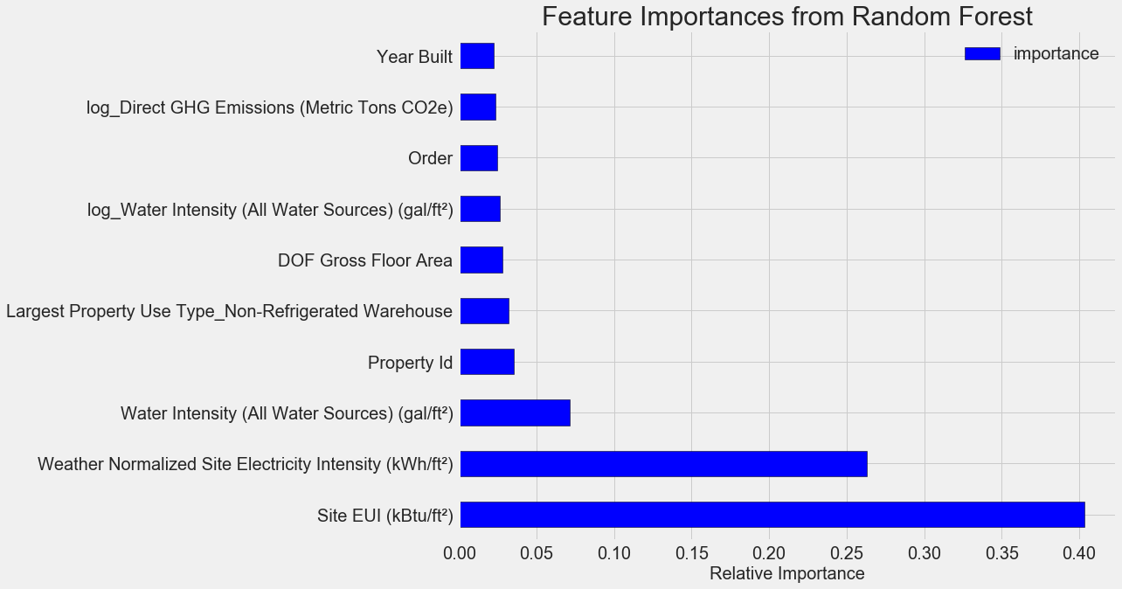
Relative Feature Importance

Slide 30
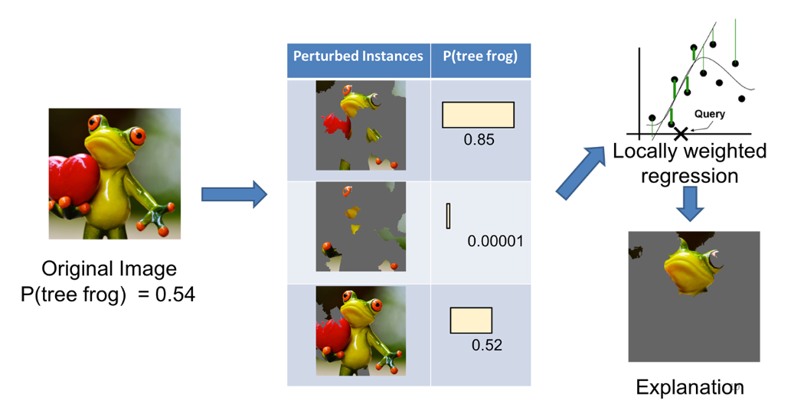
Local Interpretable Model-Agnostic Explanations

Slide 31
Machine Learning from Scratch

Slide 32
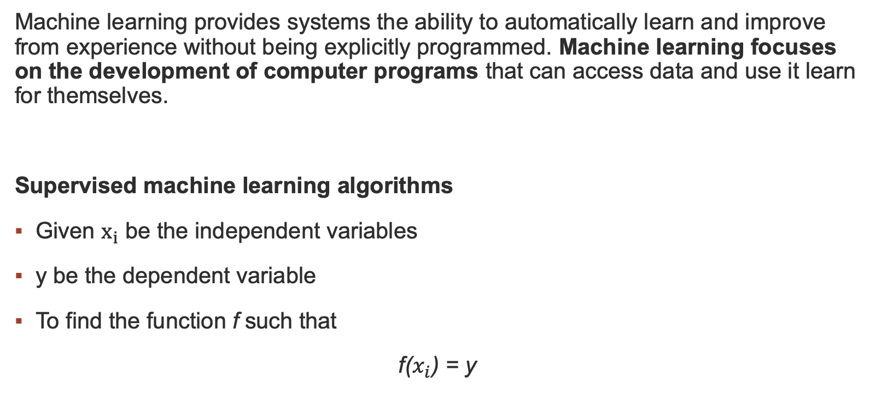
Machine Learning
Machine learning provides systems the ability to automatically learn and improve from experience without being explicitly programmed. Machine learning focuses on the development of computer programs that can access data and use it learn for themselves.
Supervised machine learning algorithms
Given $x_{i}$ be the independent variables
y be the dependent variable
To find the function f such that
f($x_{i}$) = y

Slide 33
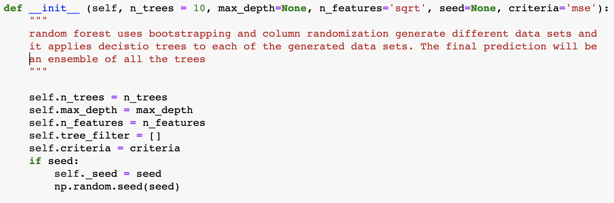
Code Structure for implementation of each algorithm
init function to initialize all the parameters required for the algorithm.

Slide 34
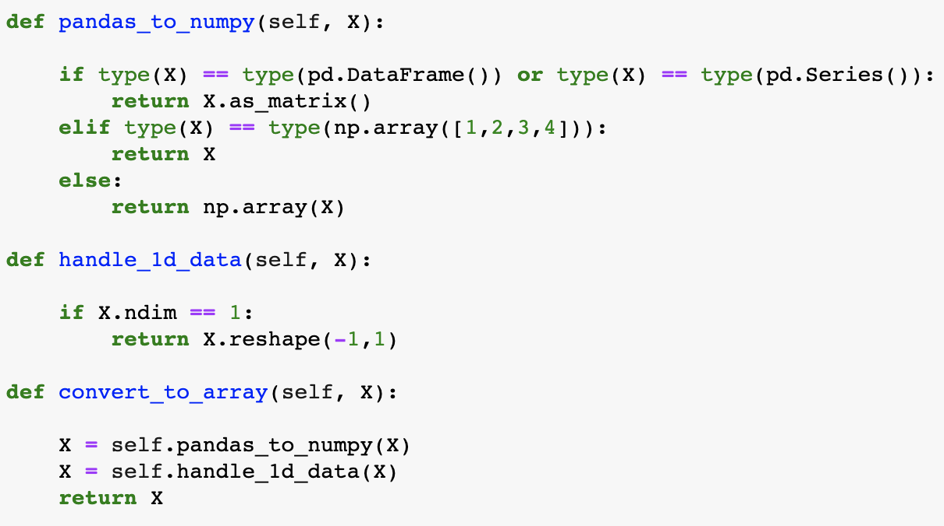
Converting data into numpy matrices

Slide 35
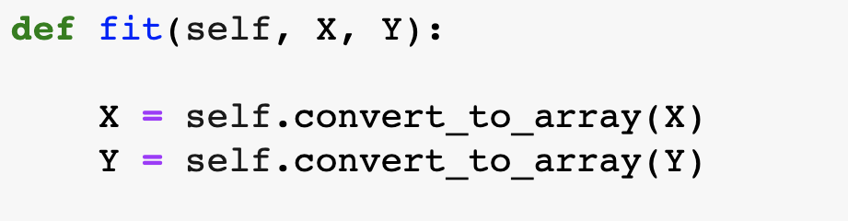
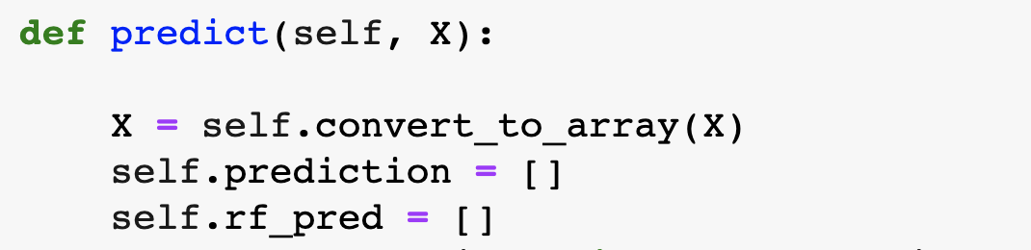
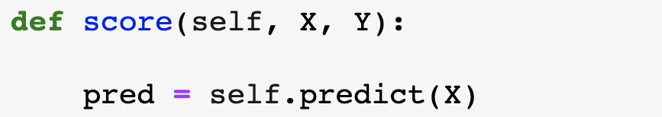
Fitting the data
Predicting the data
Calculating the score

Slide 36
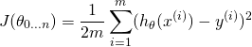
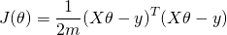
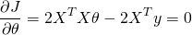
Linear Regression
Hypothesis function:
Cost function:
Calculating the values of 𝜽 such that cost function is minimum

Slide 37
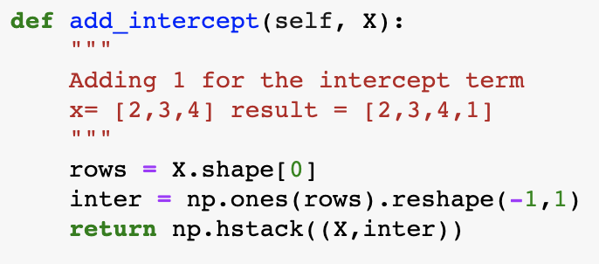
Implementation of Linear Regression
Adding a column of 1s to the feature matrix

Slide 38
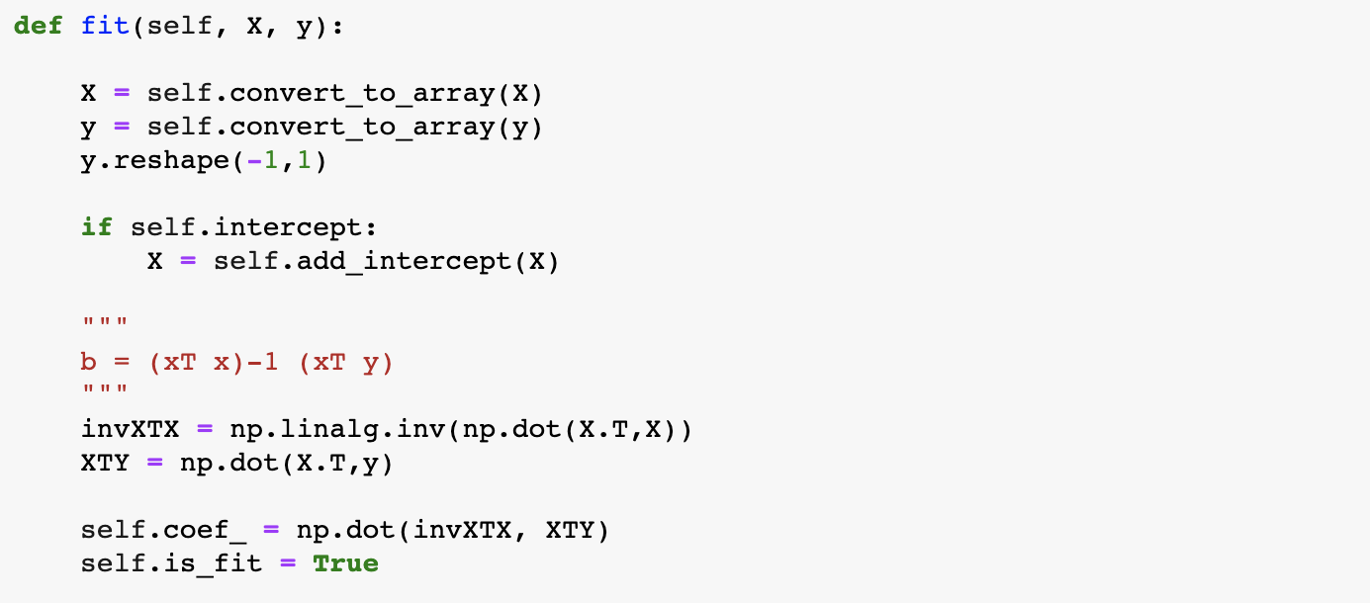
Fitting the model

Slide 39
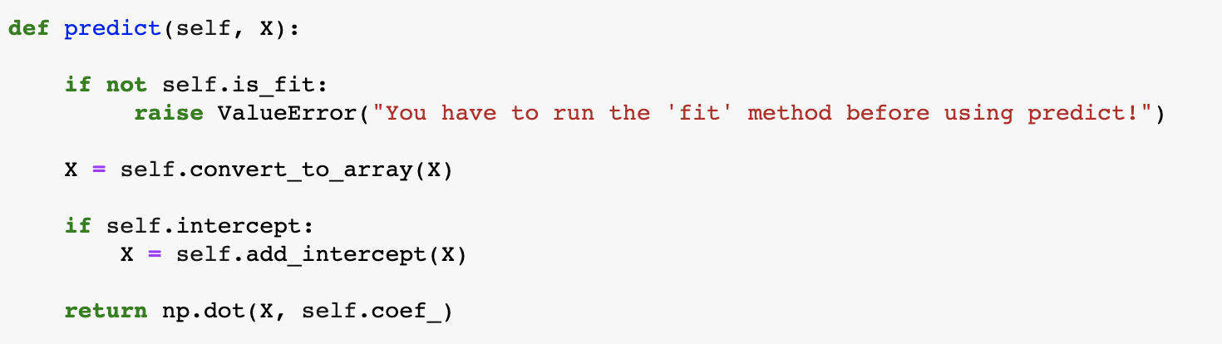
Prediction

Slide 40
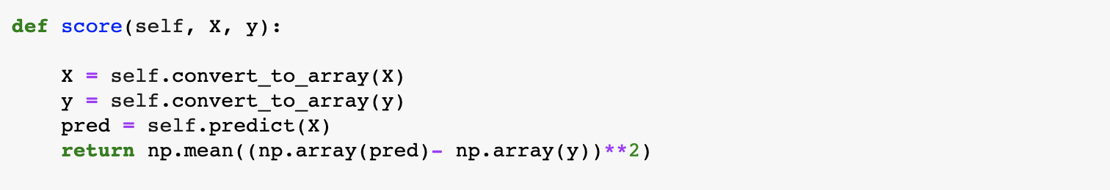
Score

Slide 41
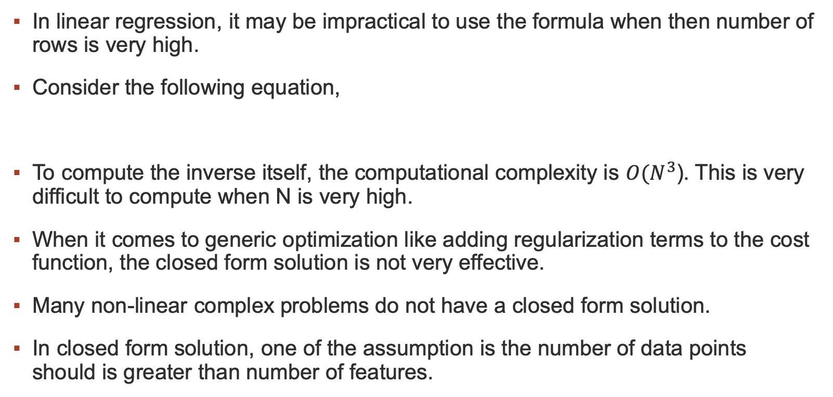
Problems with closed form solution
In linear regression, it may be impractical to use the formula when then number of rows is very high.
Consider the following equation,
To compute the inverse itself, the computational complexity is ${O(N}^{3}$). This is very difficult to compute when N is very high.
When it comes to generic optimization like adding regularization terms to the cost function, the closed form solution is not very effective.
Many non-linear complex problems do not have a closed form solution.
In closed form solution, one of the assumption is the number of data points should is greater than number of features.

Slide 42
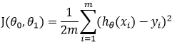
Gradient Descent Algorithm
Cost Function:
Finding the parameters such that the cost function is minimum:

Slide 43
Stochastic Gradient Descent
In stochastic Gradient Descent, we use one example or one training sample at each iteration instead of using whole dataset to sum all for every steps
SGD is widely used for larger dataset trainings and computationally faster and can be trained in parallel
Need to randomly shuffle the training examples before calculating it
Error term

Slide 44
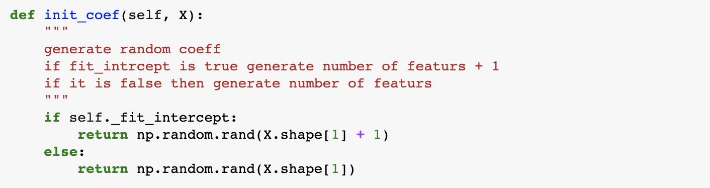
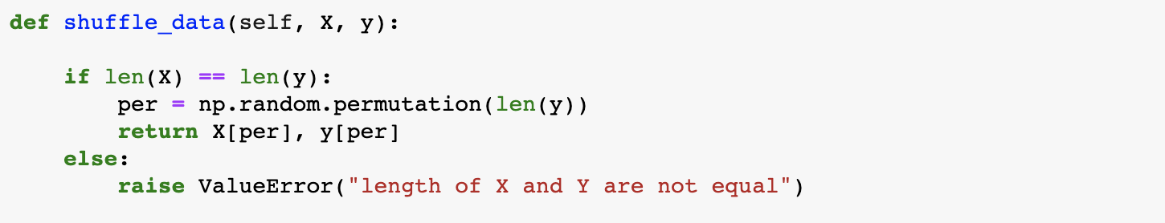
Implementation
Initializing coefficients
Shuffling data

Slide 45
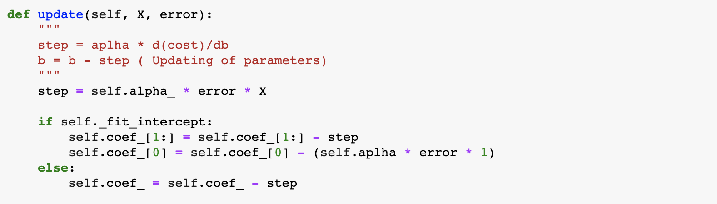
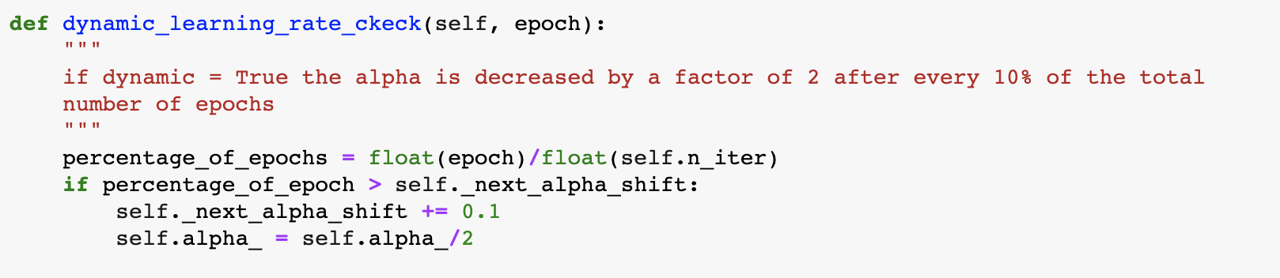
Update
Dynamic learning rate

Slide 46
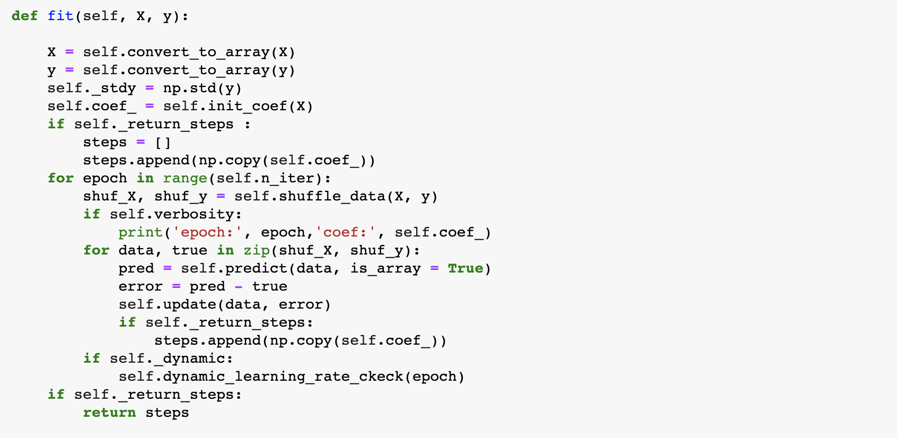
Fitting the data

Slide 47
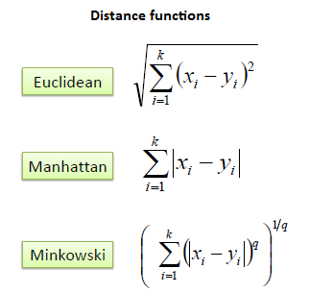
KNN Regressor and Classifier
KNN is a simple algorithm that stores all available cases and classifies new cases based on a similarity measure.
It belongs to a non-parametric machine learning algorithm.
Similarity Measures
For numeric features: For Categorical features:
Euclidean Hamming
Manhattan

Slide 48
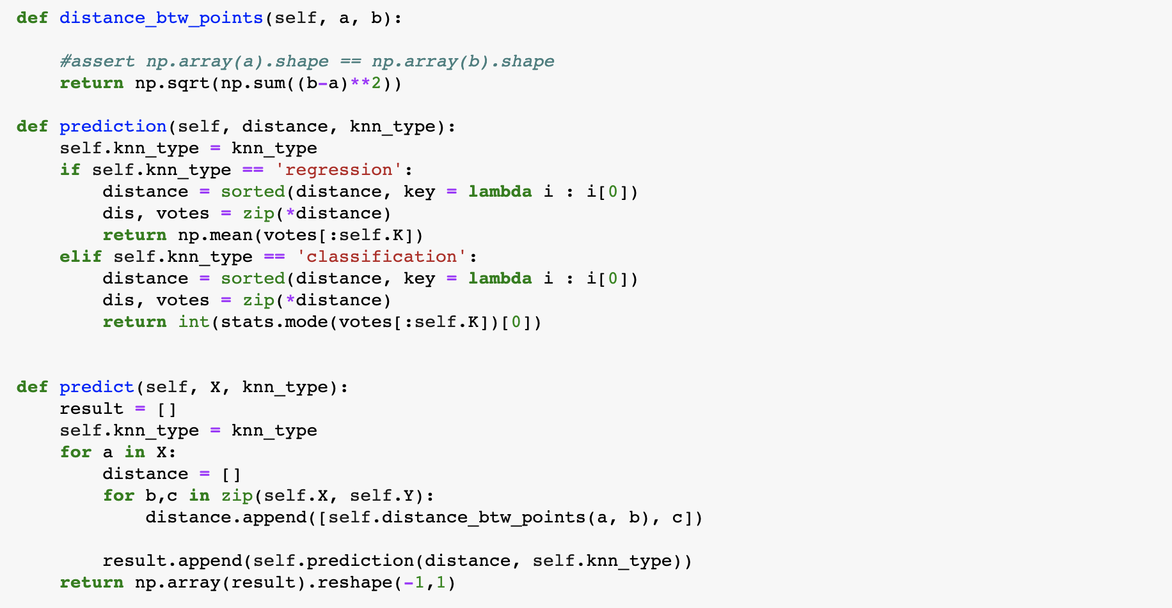
Implementation

Slide 49
Benefits of Nonparametric Machine Learning Algorithms:
Flexibility: Capable of fitting a large number of functional forms.
Power: No assumptions (or weak assumptions) about the underlying function.
Performance: Can result in higher performance models for prediction.
Limitations of Nonparametric Machine Learning Algorithms:
More data: Require a lot more training data to estimate the mapping function.
Overfitting: More of a risk to overfit the training data and it is harder to explain why specific predictions are made.

Slide 50
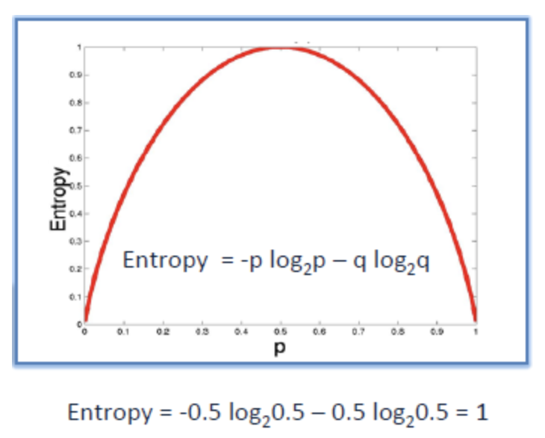
Decision Tree
Entropy
where p is the proportion of i.
If the branch is homogenous, the entropy is 0.
If the branch has equal proportions of all classes, the entropy is 1
Information Gain
Information gain = entropy(parent) - (weighted average) * entropy(children)

Slide 51

Implementation

Slide 52

Entropy

Slide 53

Fitting the data

Slide 54

Fitting the data

Slide 55


Slide 56


Slide 57

Prediction

Slide 58
Limitations of Decision Trees
Decision trees tend to have high variance since they tend to overfit on training data. This leads to poor performance on unseen data.
Using ensemble methods, we can create models that utilize underlying decision trees as a foundation for producing powerful results.

Slide 59
Bagging Classifier and Regressor
Bootstrap aggregating or Bagging is a process of creating an ensemble (forest) of trees where multiple training sets are generated with replacement.
This approach helps reduce variance by averaging the ensemble's results, creating a majority-votes model.

Slide 60

Implementation

Slide 61

Prediction

Slide 62
Limitations
The main limitation of bagging trees is that it uses the entire feature space when creating splits in the trees.
If some variables within the feature space are indicative of certain predictions, you run the risk of having a forest of correlated trees, thereby increasing bias and reducing variance.
However, a simple tweak of the bagging trees methodology can prove advantageous to the model’s predictive power like Random Forest.

Slide 63
Random Forest
Random forest aims to reduce the previously mentioned correlation issue by choosing only a subsample of the feature space at each split.
It aims to make the trees de-correlated and prune the trees by setting a stopping criteria for node splits.

Slide 64

Implementation

Slide 65


Slide 66

Prediction

Slide 67
Optimal Portfolio

Slide 68
Project 3: Optimal Portfolio
Problem Statement
Build portfolios using top 15 S&P 500 companies. Find the optimal portfolios to invest in using historic data.
Approach
To create a portfolio with maximum returns and minimum risk.

Slide 69
Workflow
Getting the data
Transforming the data
Converting the objective into mathematical equations
Finding the optimal investments in each company for a portfolio
Determining the portfolio I would invest in.

Slide 70

Getting the data
Quandl API for data

Slide 71

Web Scraping to get tickers of companies

Slide 72



Transforming the data - Pivoting

Slide 73

Calculating Expected Returns for each stock
Monthly expected returns = $\frac{Closing Price\left(i\right)−Closing Price(i−1)}{Closing Price(i)}$ -1
Annual expected returns = Mean monthly returns * 12

Slide 74

Calculating Expected Returns of a portfolio
Returns of a portfolio:
Let N be the number of companies/stocks.
$E_{i}$ be the expected annual return of $i^{th}$ company.
$W_{i}$ be the fraction of your investment in $i^{th}$ company.
Portfolio Returns = $\sum_{i=0}^{N}{{ W}_{i} ∗ }$ $E_{i}$
Variance of a portfolio:
Let σ_{i}² be the standard deviation of $i^{th}$ company.
ρ_{i,j} be the covariance between $i^{th}$ and $j^{th}$ company.
Portfolio Variance = w₁²σ₁² + w₂²σ₂² + w₃²σ₃² +………..+ w_{n}²σ_{n}²
+ 2w₁w₂σ₁σ₂ρ_{1,2} + 2w₂w₃σ₂σ₃ρ_{2,3} + 2w₁w₃σ₁σ₃ρ_{1,3} +……….

Slide 75

Matrix Equivalents of Portfolio Returns and Variance
Let’s say we have N companies and x is a vector of initial random weighs for the portfolio, μ is a vector of the average returns and σ2 is an N×N covariance matrix.
Portfolio Return = np.dot(x, μ)
Portfolio Risk = np.sqrt(np.dot(x.T, np.dot(σ2 , x)))

Slide 76
Optimizing weights to minimize risk for a given expected return
Objective function:
Minimizing variance i.e., minimize np.sqrt(np.dot(x.T, np.dot(σ2 , x)))
Constraints:
Portfolio returns = Target returns
Sum of weights = 1
Each individual weight is greater then 0 and less than 1

Slide 77

Implementation

Slide 78

Minimizing the standard deviation

Slide 79

Risk Vs Returns

Slide 80
Portfolio I would invest in
I would invest in a portfolio that has maximum returns with minimum risk. To find this portfolio, I want to maximize the ratio of returns over risk.
Objective function:
Maximize returns/risk ratio.
Constrains:
Sum of weights = 1
Each individual weight is greater then 0 and less than 1

Slide 81

Implementation

Slide 82
Adding short sale constraints
Including short sale constraints can have negative weights. Therefore, we allow negative values for the optimization of weights.
Objective function:
minimize np.sqrt(np.dot(x.T, np.dot(σ2 , x)))
Constraints:
portfolio returns = Target returns
sum of weights = 1

Slide 83

Optimal portfolios with short sales

Slide 84
Thank You

